Slide 1

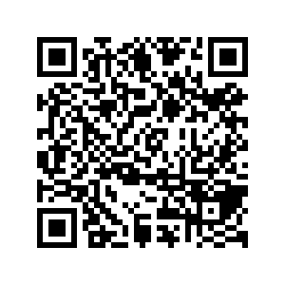
CS1010: Programming Methodology
UNIT 21
The assert Macro
Live Q&A
https://pollev.com/jin

Slide 2
Unit 21: The assert Macro
assert

Slide 3
assert
Checks an assertion
long nrows = 20;
long ncols = 10;
long matrix[nrows][ncols];
…
// Assertion: i >= 0 && i < nrows && j >= 0 && j < ncols
matrix[i][j] = -1;
…
long nrows = 20;
long ncols = 10;
long matrix[nrows][ncols];
…
assert(i >= 0 && i < nrows && j >= 0 && j < ncols);
matrix[i][j] = -1;
…

Slide 4
assert
If the assertion fails, the program exits with a message.
assert: assert.c:12: int main(): Assertion `i >= 0 && i < nrows && j >= 0 && j < ncols' failed.
Aborted
long nrows = 20;
long ncols = 10;
long matrix[nrows][ncols];
for (long i = 0; i < nrows; i+=1){
j = i + 1; // logical error!
assert(i >= 0 && i < nrows && j >= 0 && j < ncols);
matrix[i][j] = -1;
}

Slide 5


assert
Not a mechanism for handling errors!
Only use it to confirm expected behaviours of your programme / check for logical issues in your program.
long input = CS1010_read_long();
assert (input >= 0);
long input = CS1010_read_long();
while (input < 0){
// print some error message and
// read the input again…
}

